Slide 1
Two overall scales of analysis
Narrow-scale
Bon Bon and surrounding areas
Broad-scale
Extent capturing all three IBRA subregions within Bon Bon
(Other than one region that extends far to the north that is excluded)

Slide 2
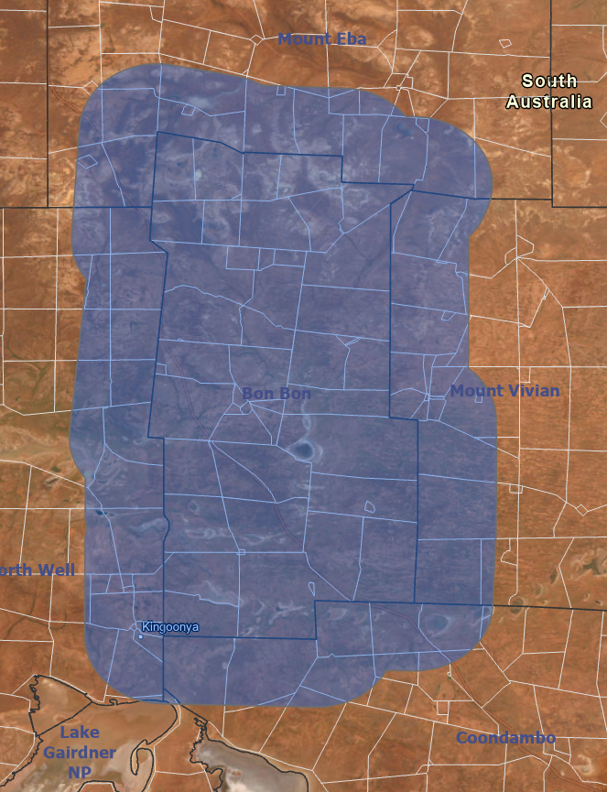
Narrow-scale analysis
Looking at Bon Bon and pixels within a 10 km buffer.
10 km buffer roughly doubles the area of BB
This includes:
Coondambo, Mt Vivian, North Well and Mt Eba
AIM:
Is there an effect of destocking at BB?

Slide 3
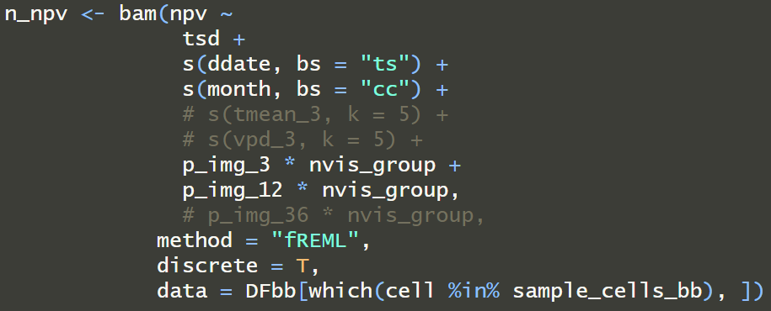
Three models
PV
NPV
Bare
Current selection of variables:
Climatic
3 month sum rainfall
12 month sum rainfall
Month of year (captures other yearly cyclical climatic variables)
Date
Explains residual variance of response variable through time not explained by other variables included in the model
Management
Time since destock (TSD)
Counts up from 2009 for Bon Bon
Continually zero for all surrounding properties

Slide 4
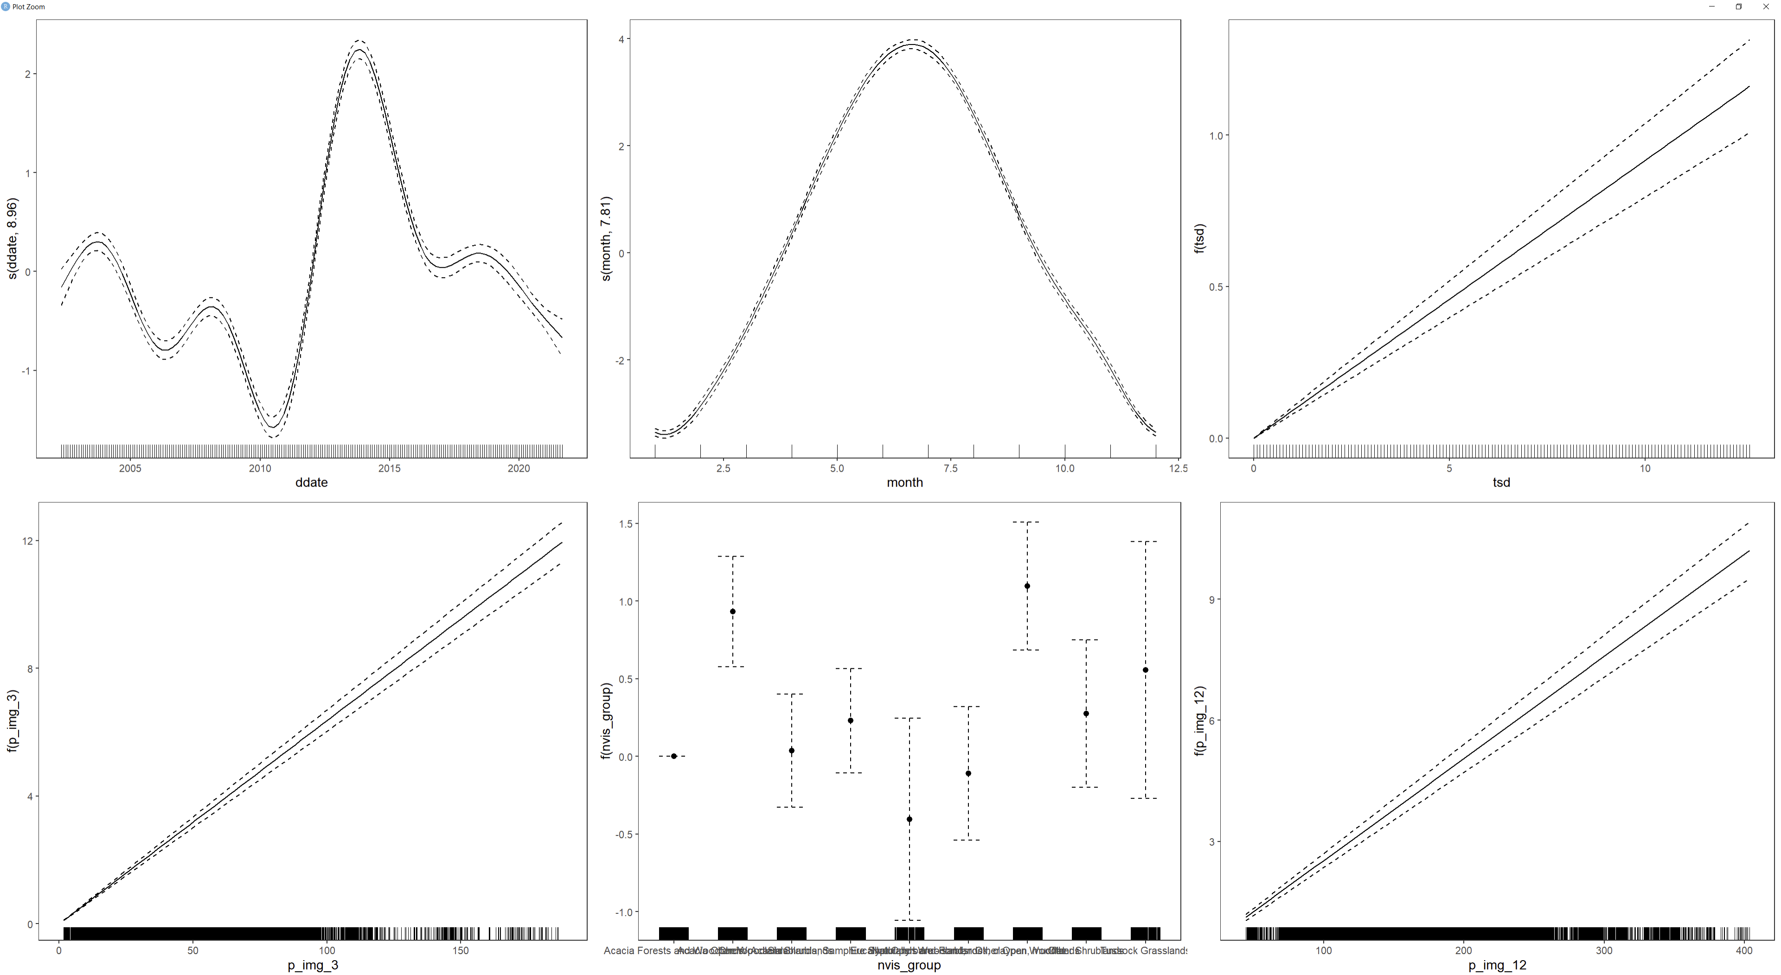
Results
Effects of each driving variable on PV (in this case)
Effect of TSD is the main output
PV

Slide 5
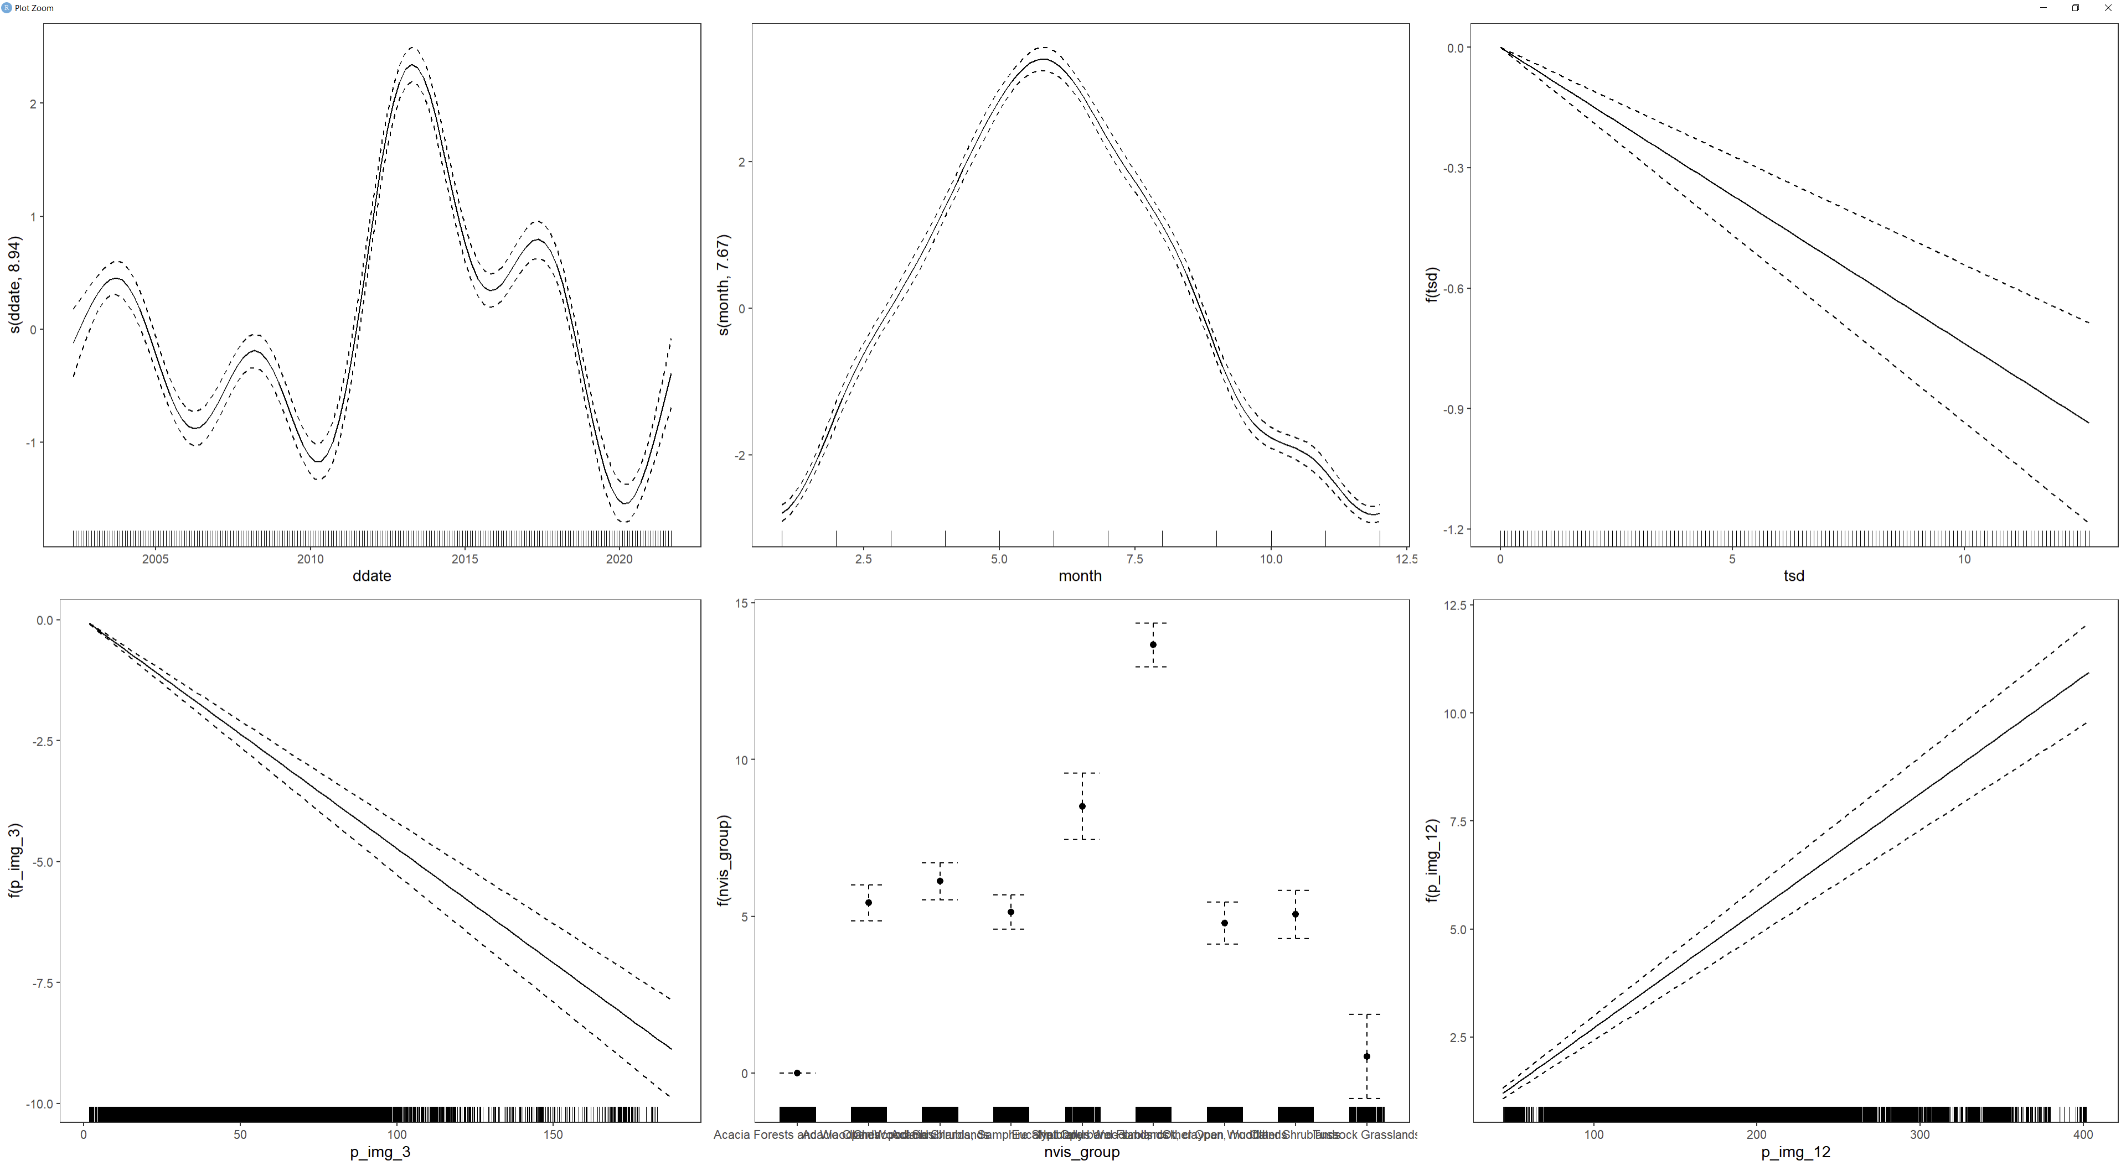
Results
NPV

Slide 6
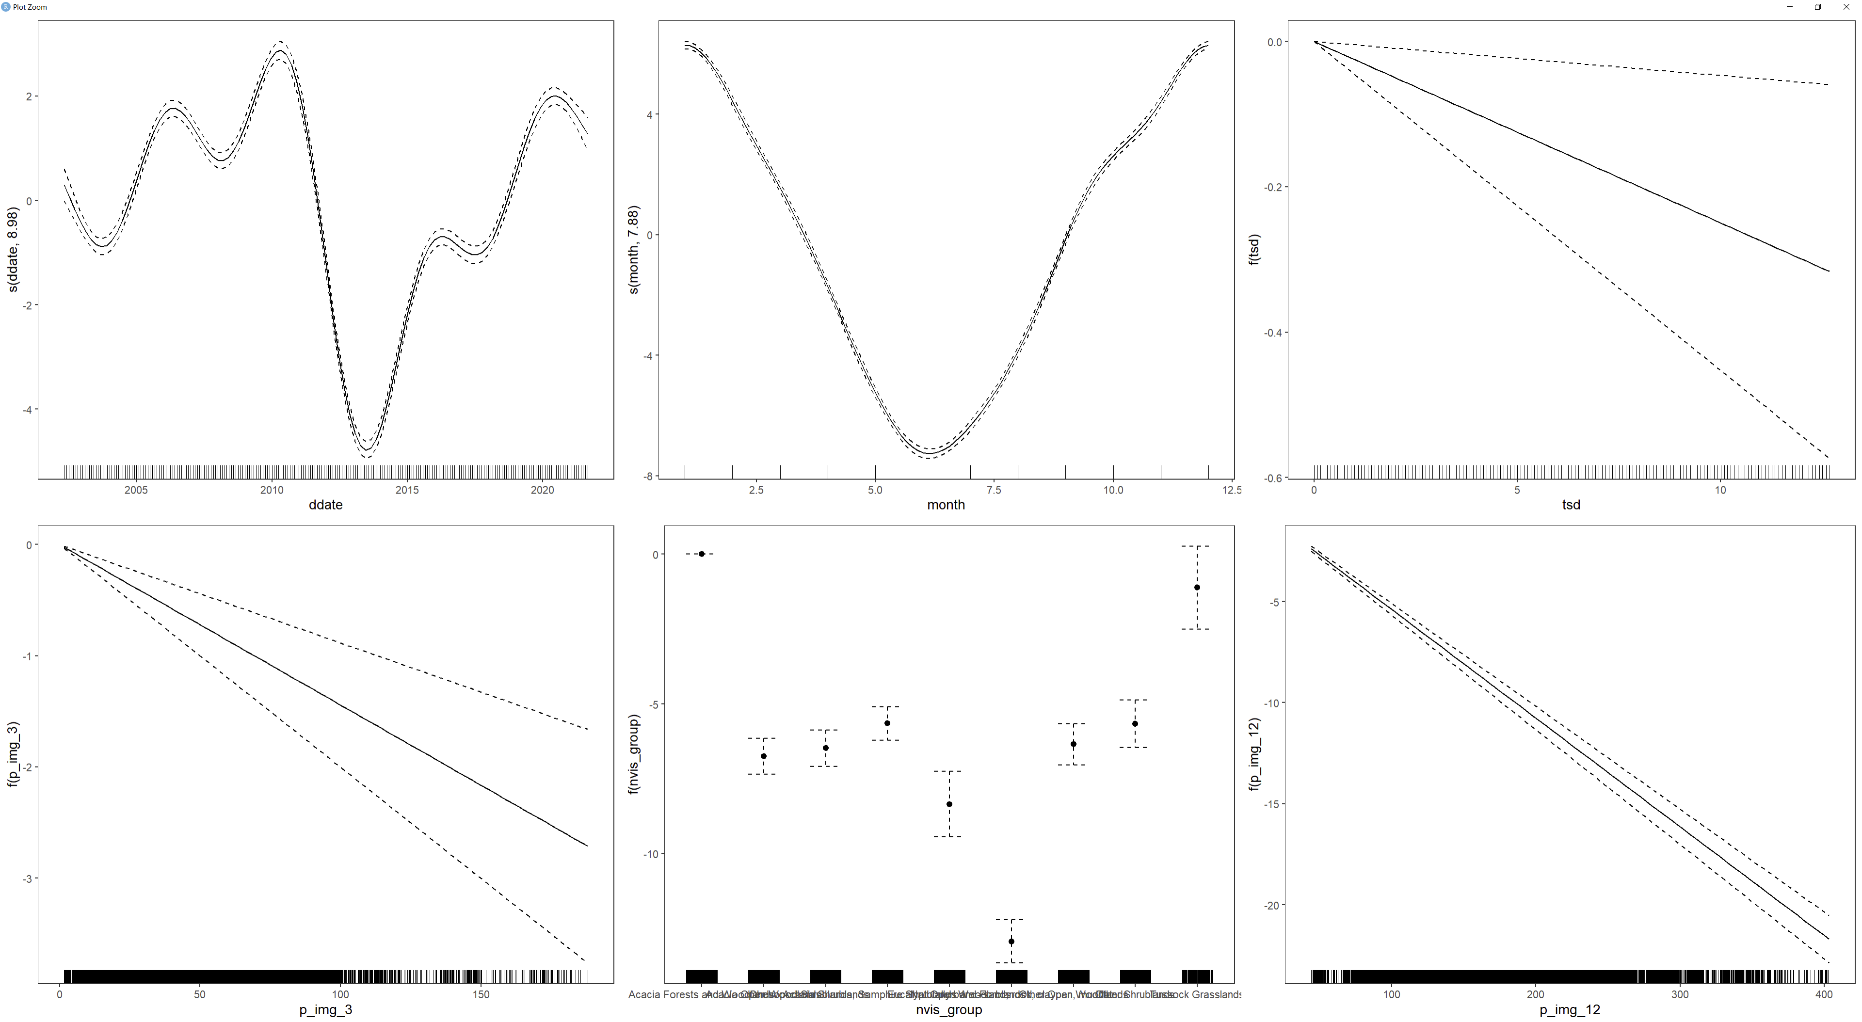
Results
Bare

Slide 7
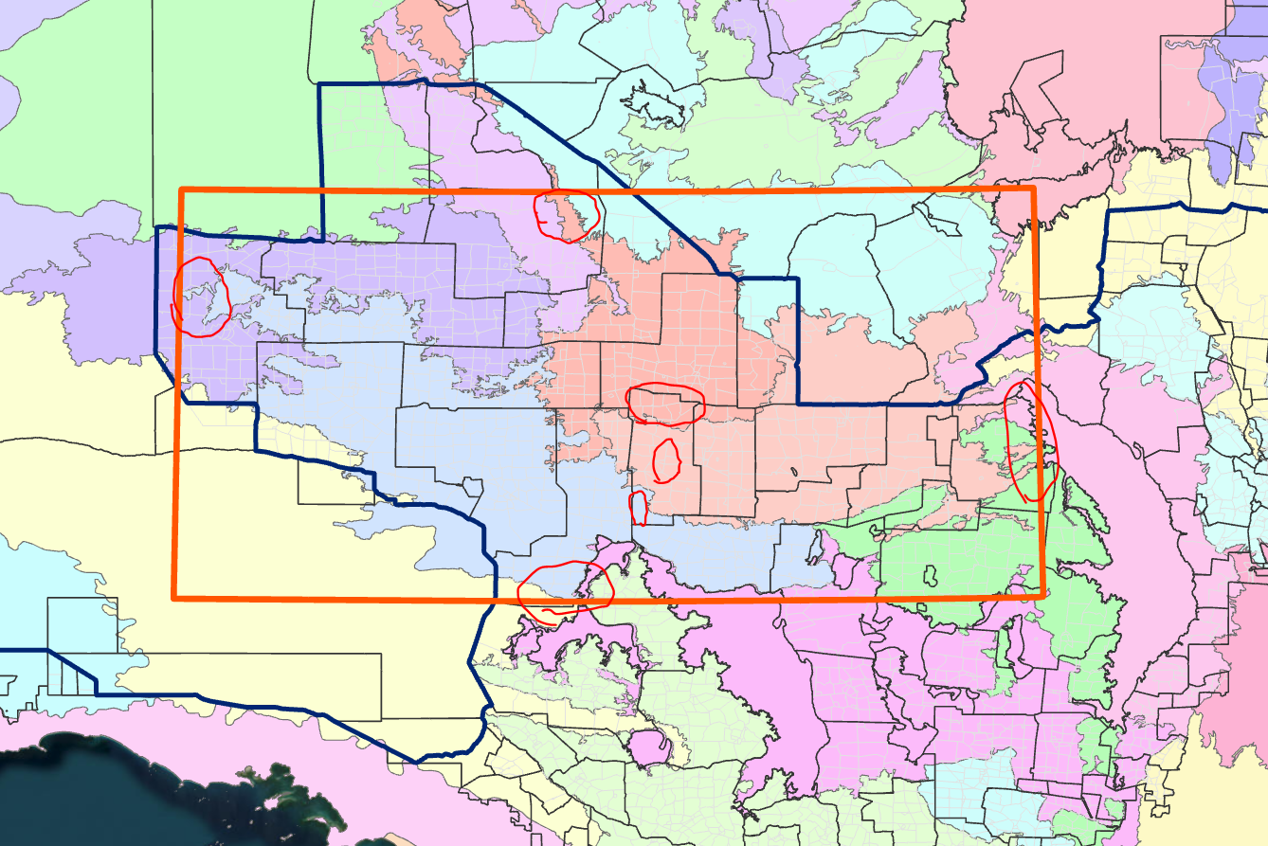
Broad-scale analysis
Looking at Bon Bon and pixels within a 10 km buffer.
10 km buffer roughly doubles the area of BB
AIM:
Are there general differences in vegetation cover between stations that could be attributed to differences in management

Slide 8
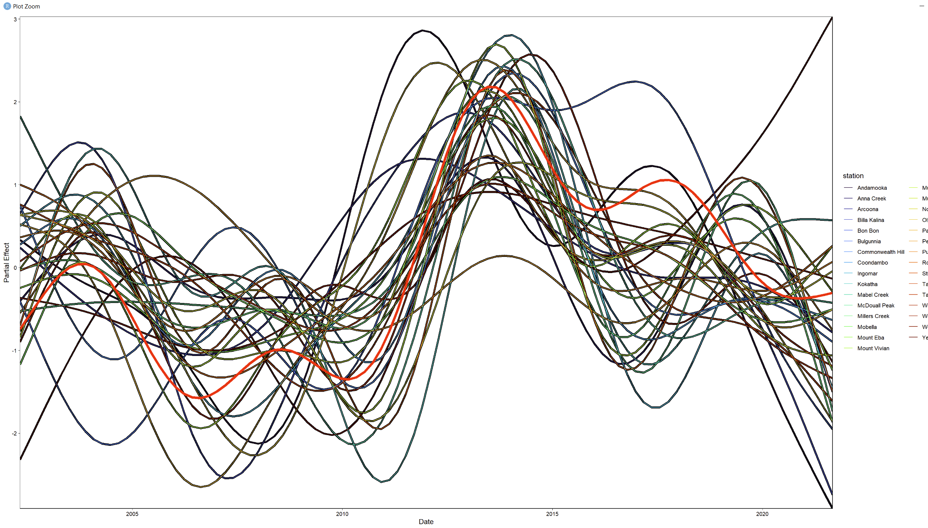
Approach
GAM seems too complicated to interpret.
Remaining effect of date on PV
that cannot be attributed to other
variables included in the model

Slide 9
Approach
Focus on the change in mean, minimum and maximum annual cover values per station.
i.e. are the cover peaks / troughs increasing or decreasing over time
Anomalies calculated based on mean cover values per pixel per month (can be set up where this mean is calculated based on pre-management dates)
Then calculate minimum, mean and maximum anomalies at yearly time steps

Slide 10
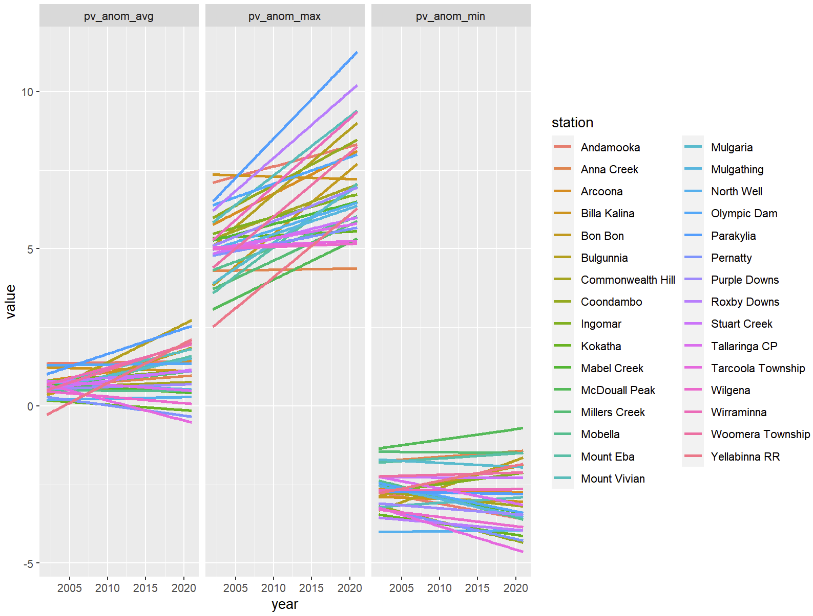
Results
Plot over time
Can highlight certain stations for comparison

Slide 11
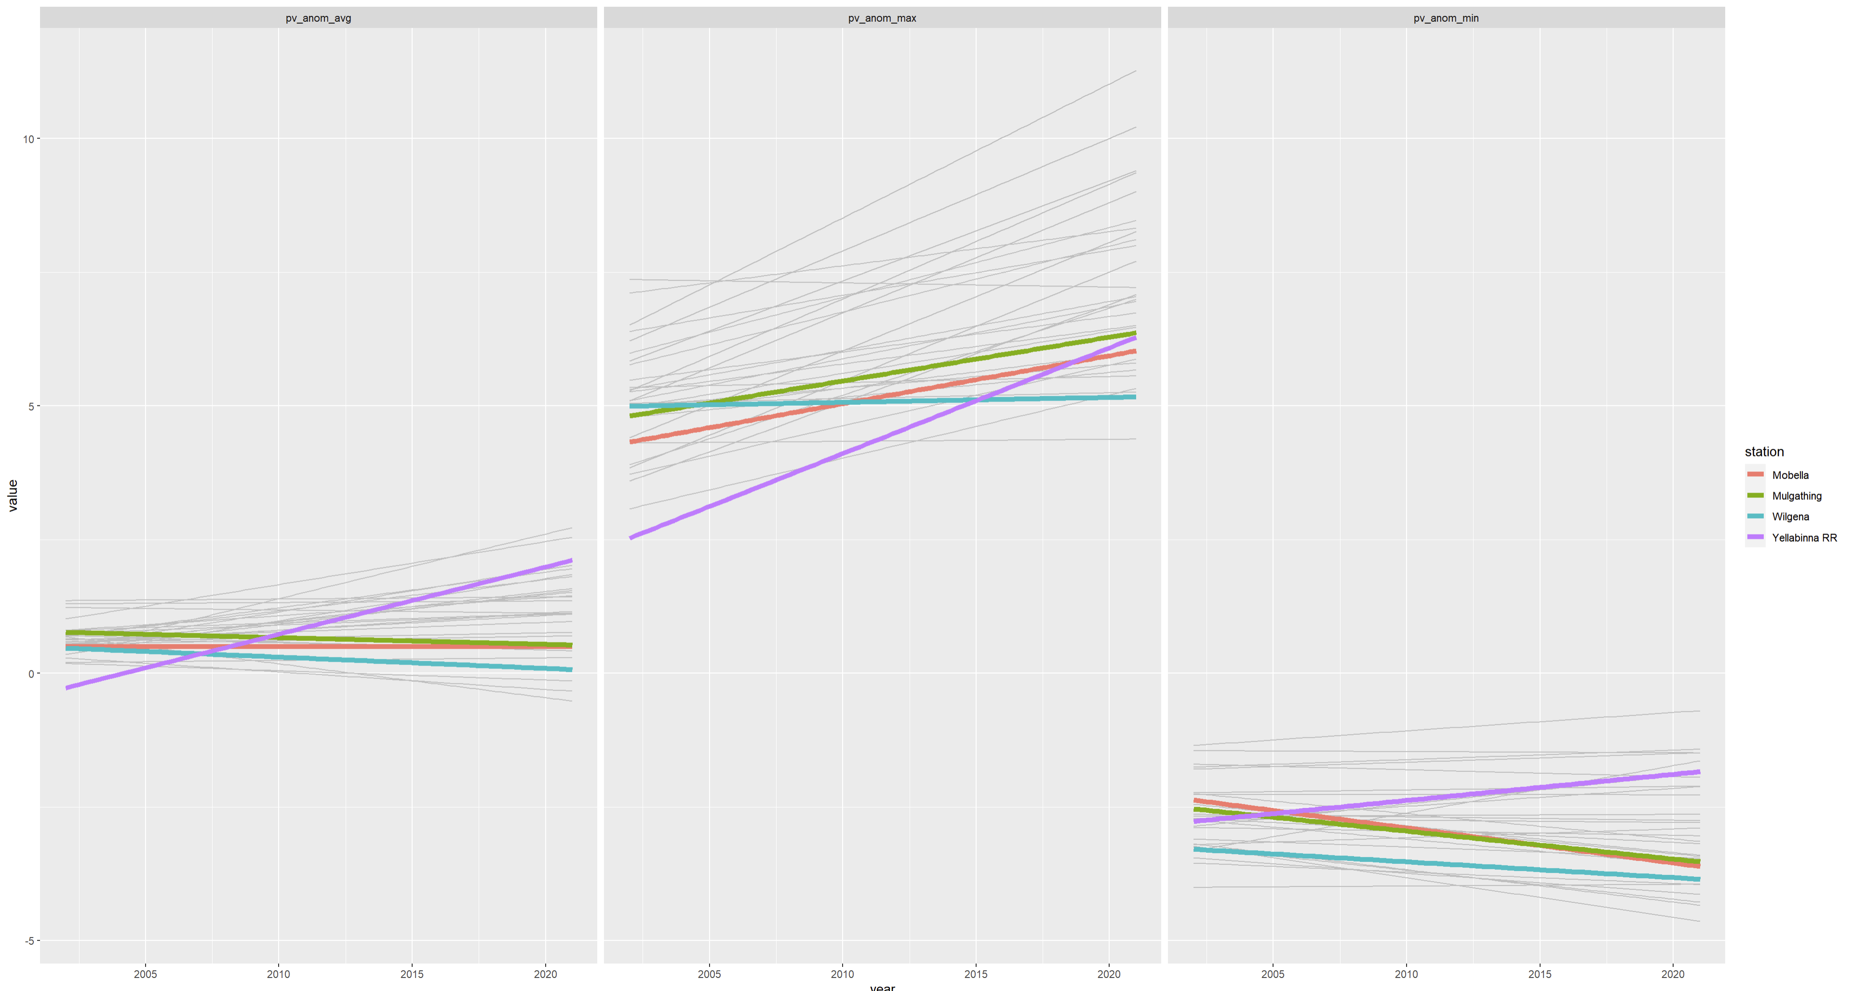
E.g. Yellabinna Regional Reserve compared to surrounding stations.
Increasing max PV anomaly over years.
Need to consider relative to starting point
E.g. did it start with low cover, therefore high potential to increase

Slide 12
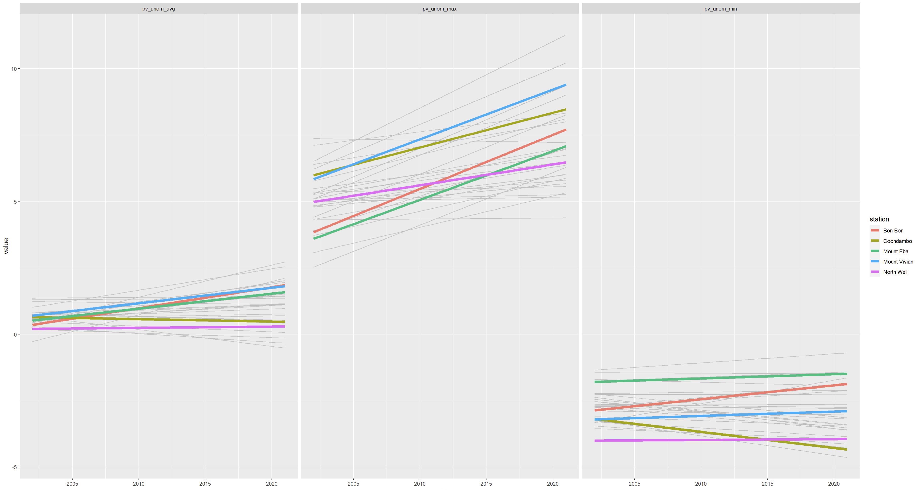
Or, the same for BB and surrounding

Slide 13
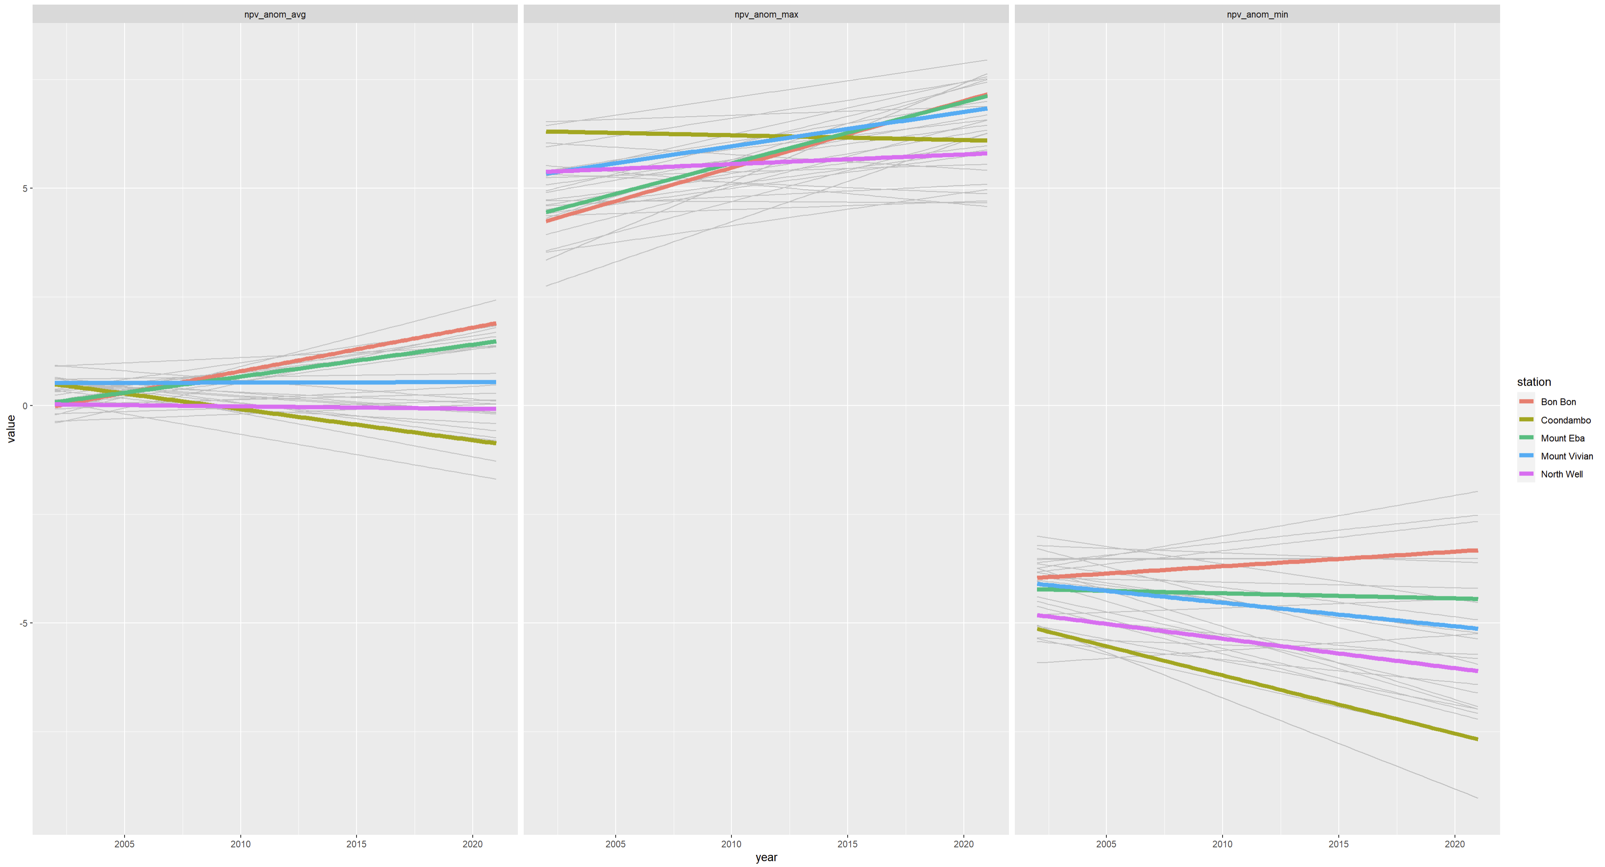
For NPV

Slide 14
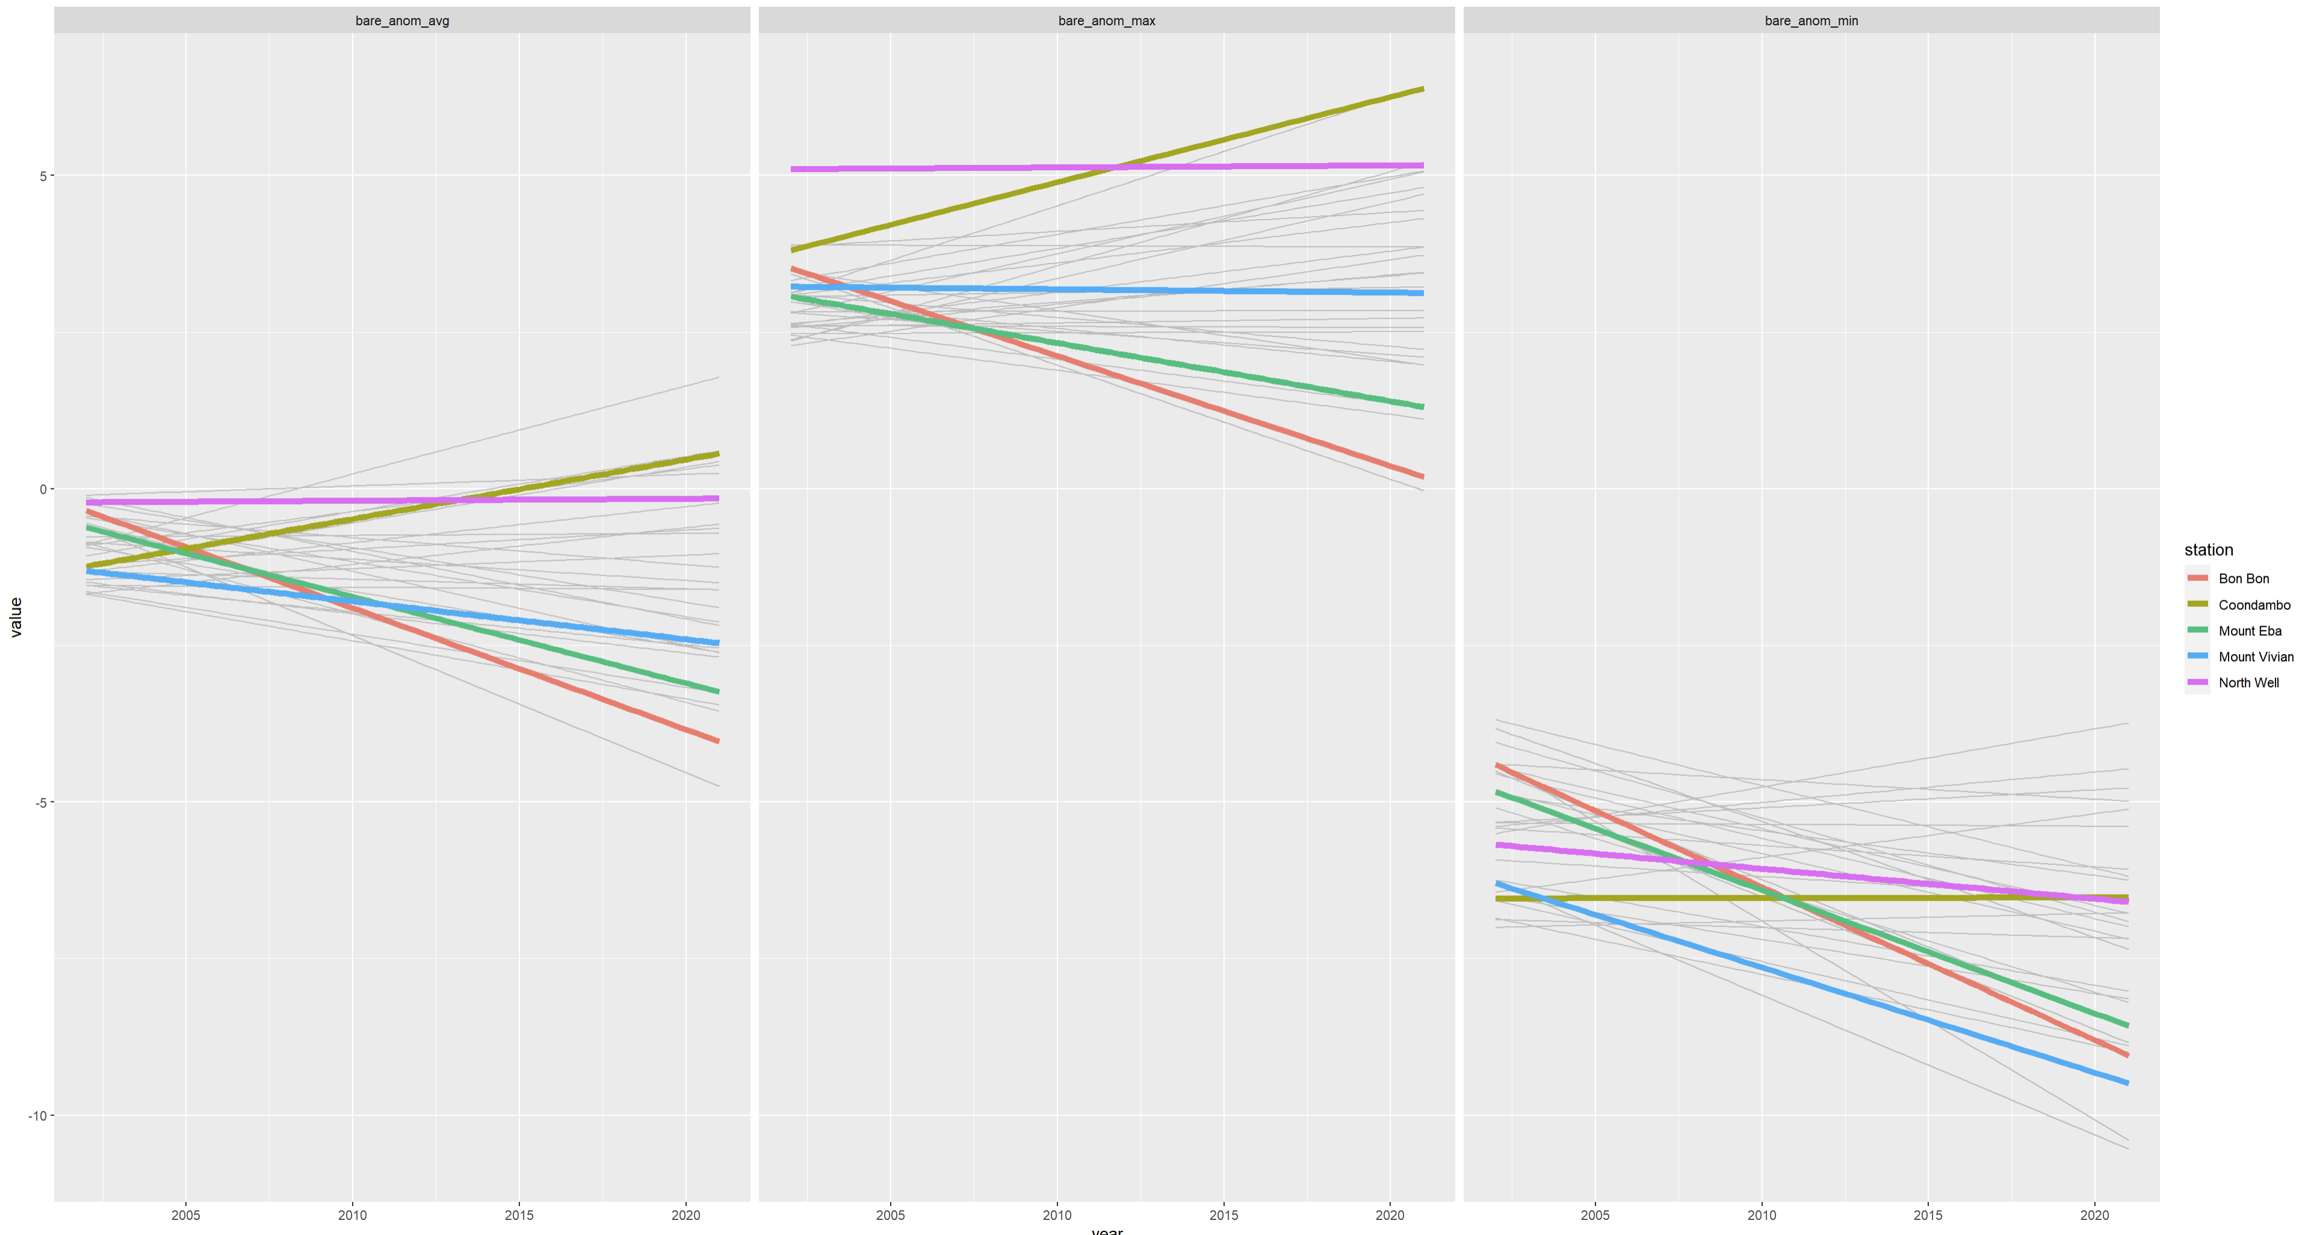

Slide 15
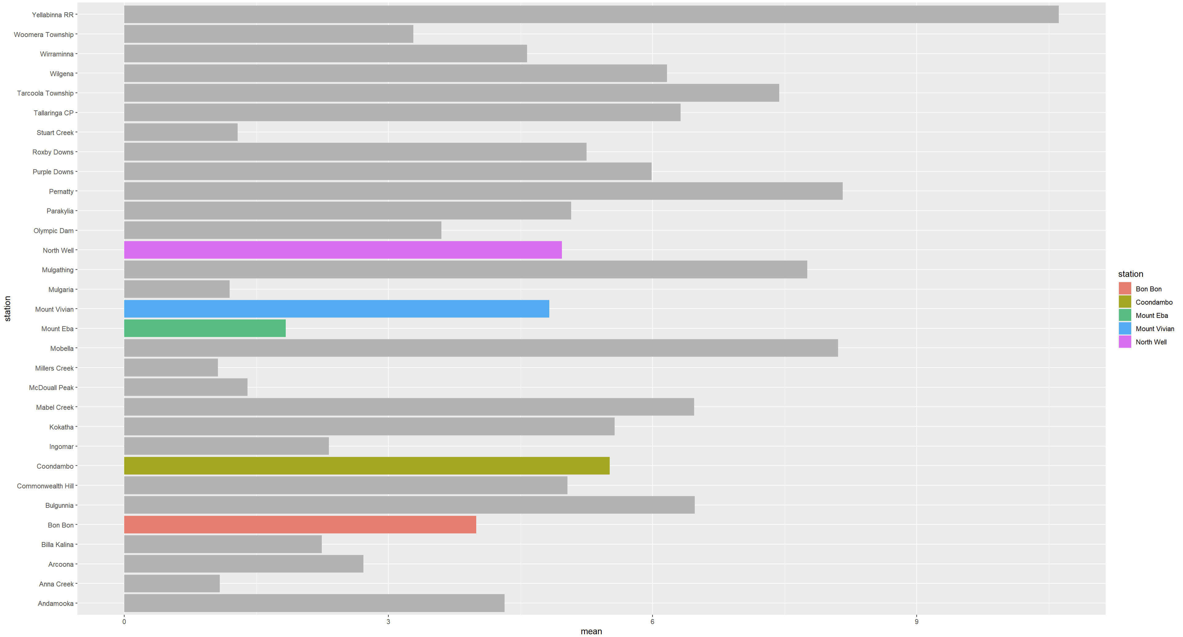
Can interpret using mean pv cover from pre-2009
BB has similar PV anom slope to Mount Eba despite Mount Eba starting at a much lower mean PV.

